Slide 1

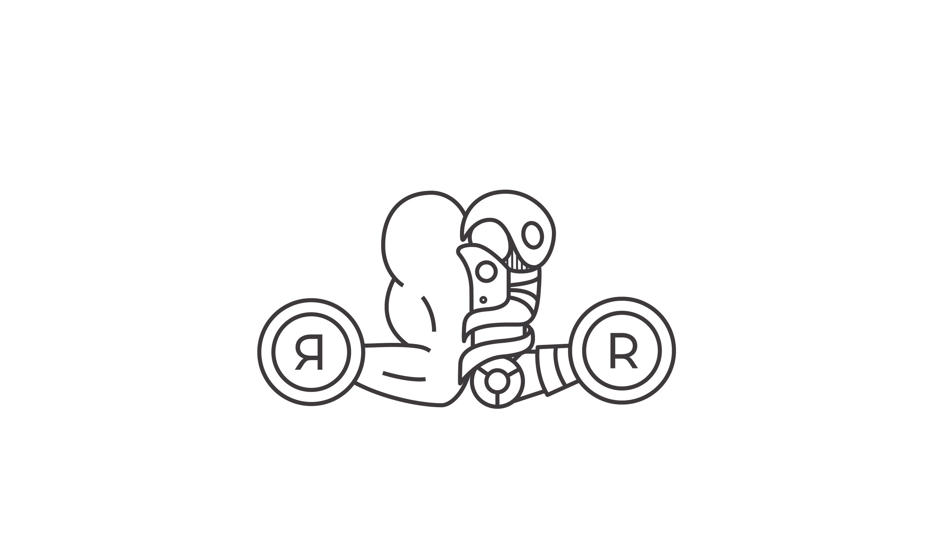
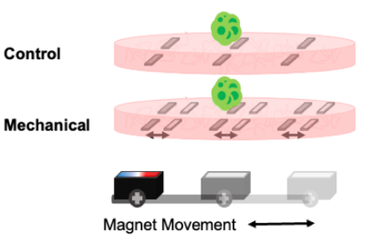
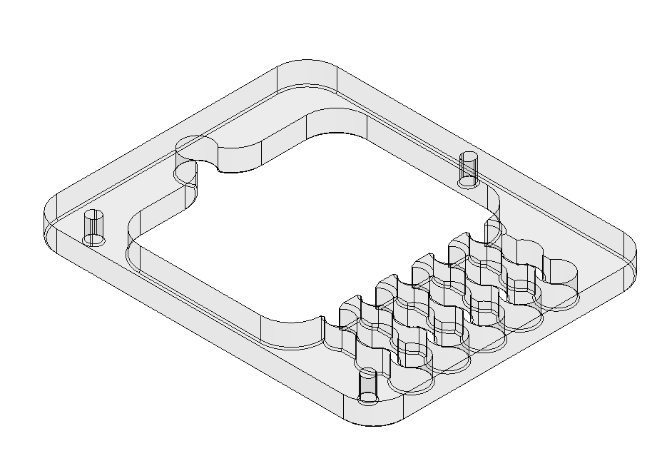
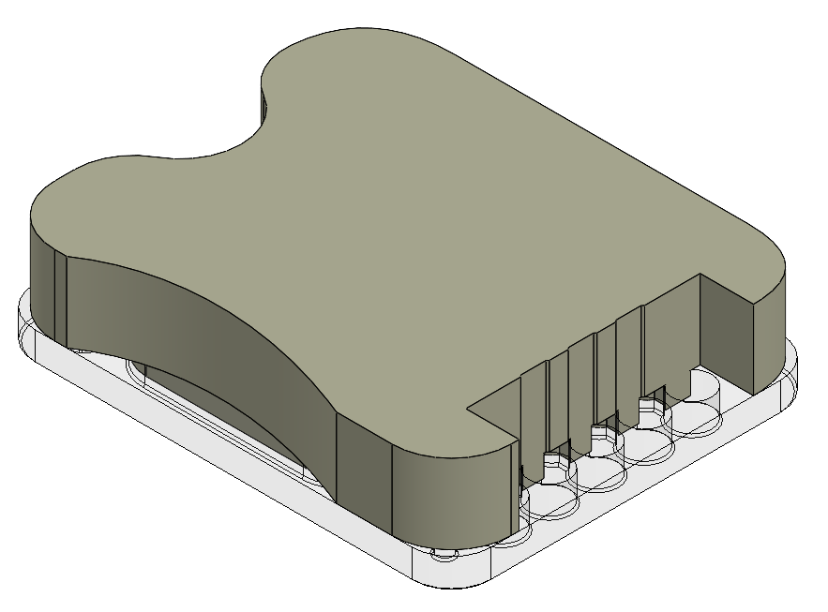
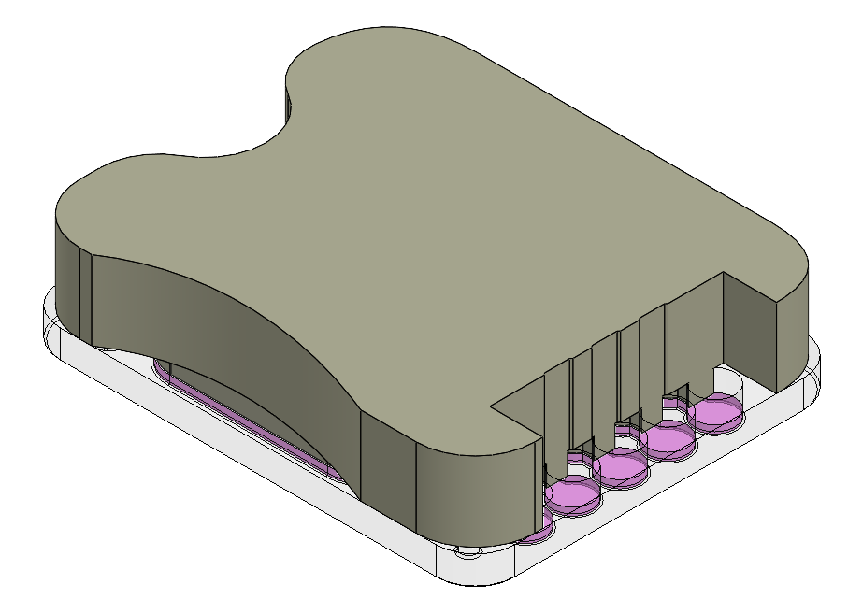
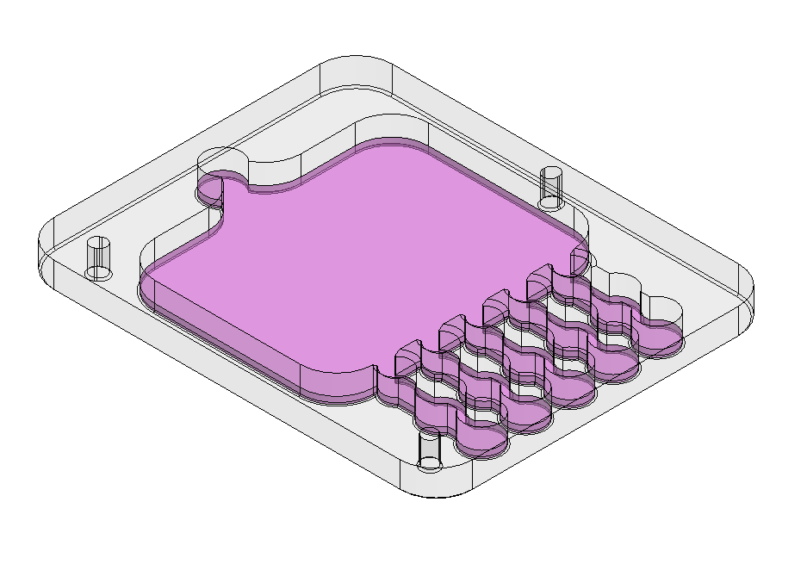
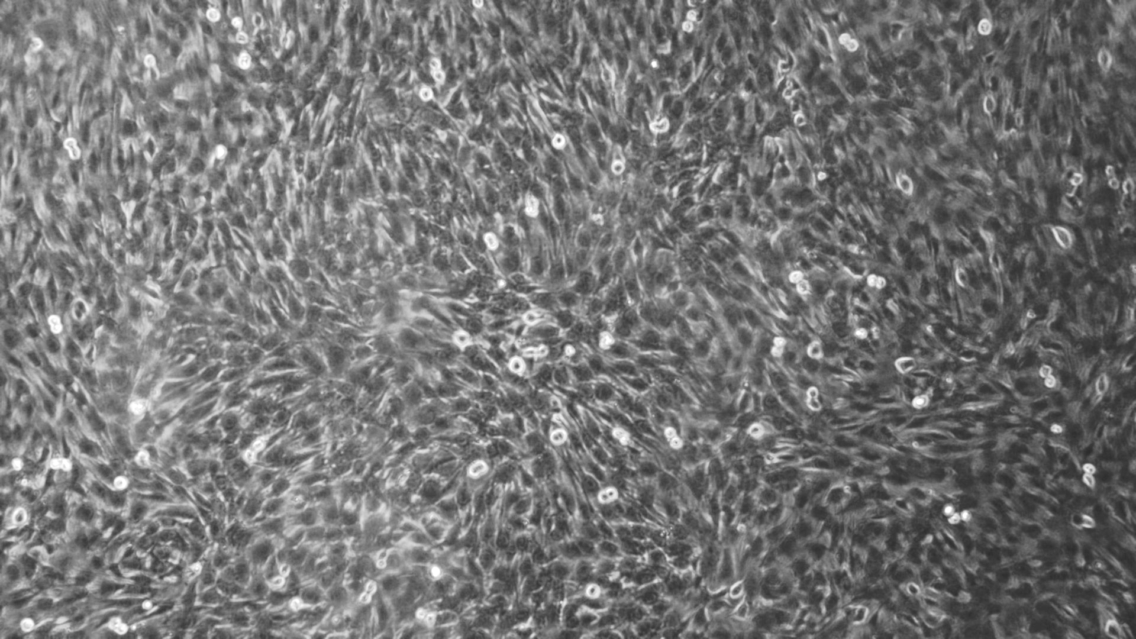
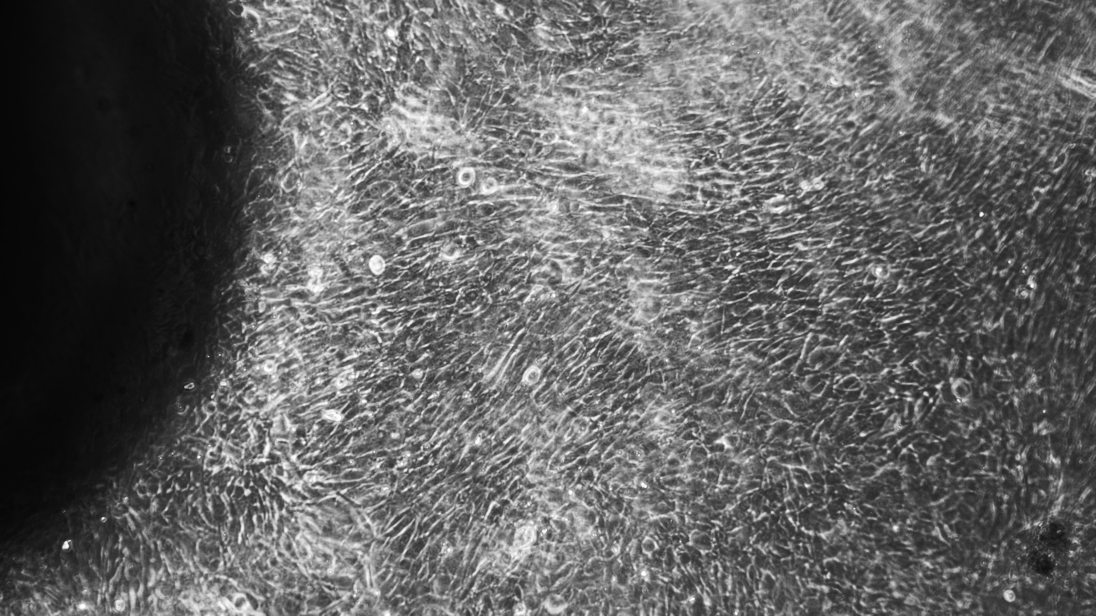
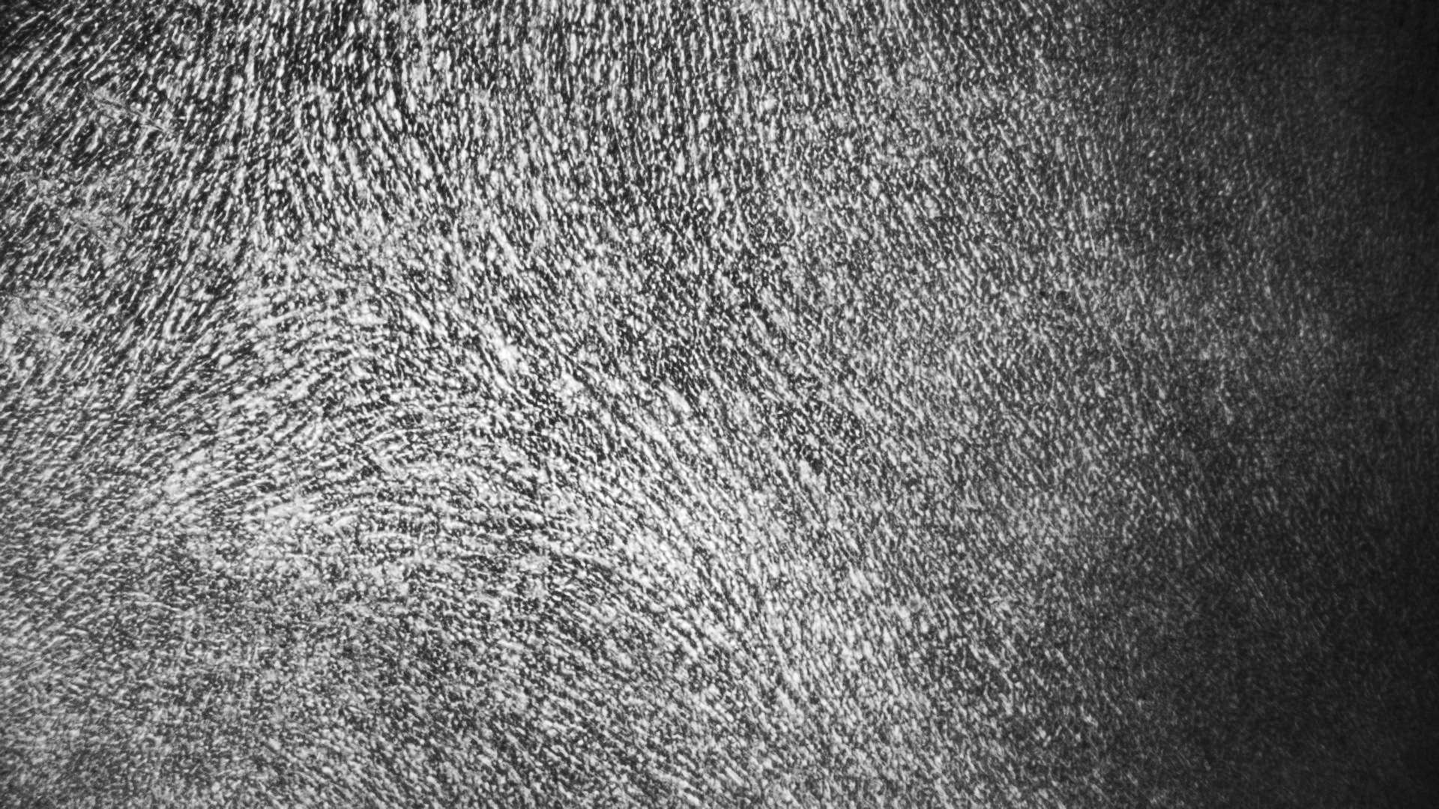
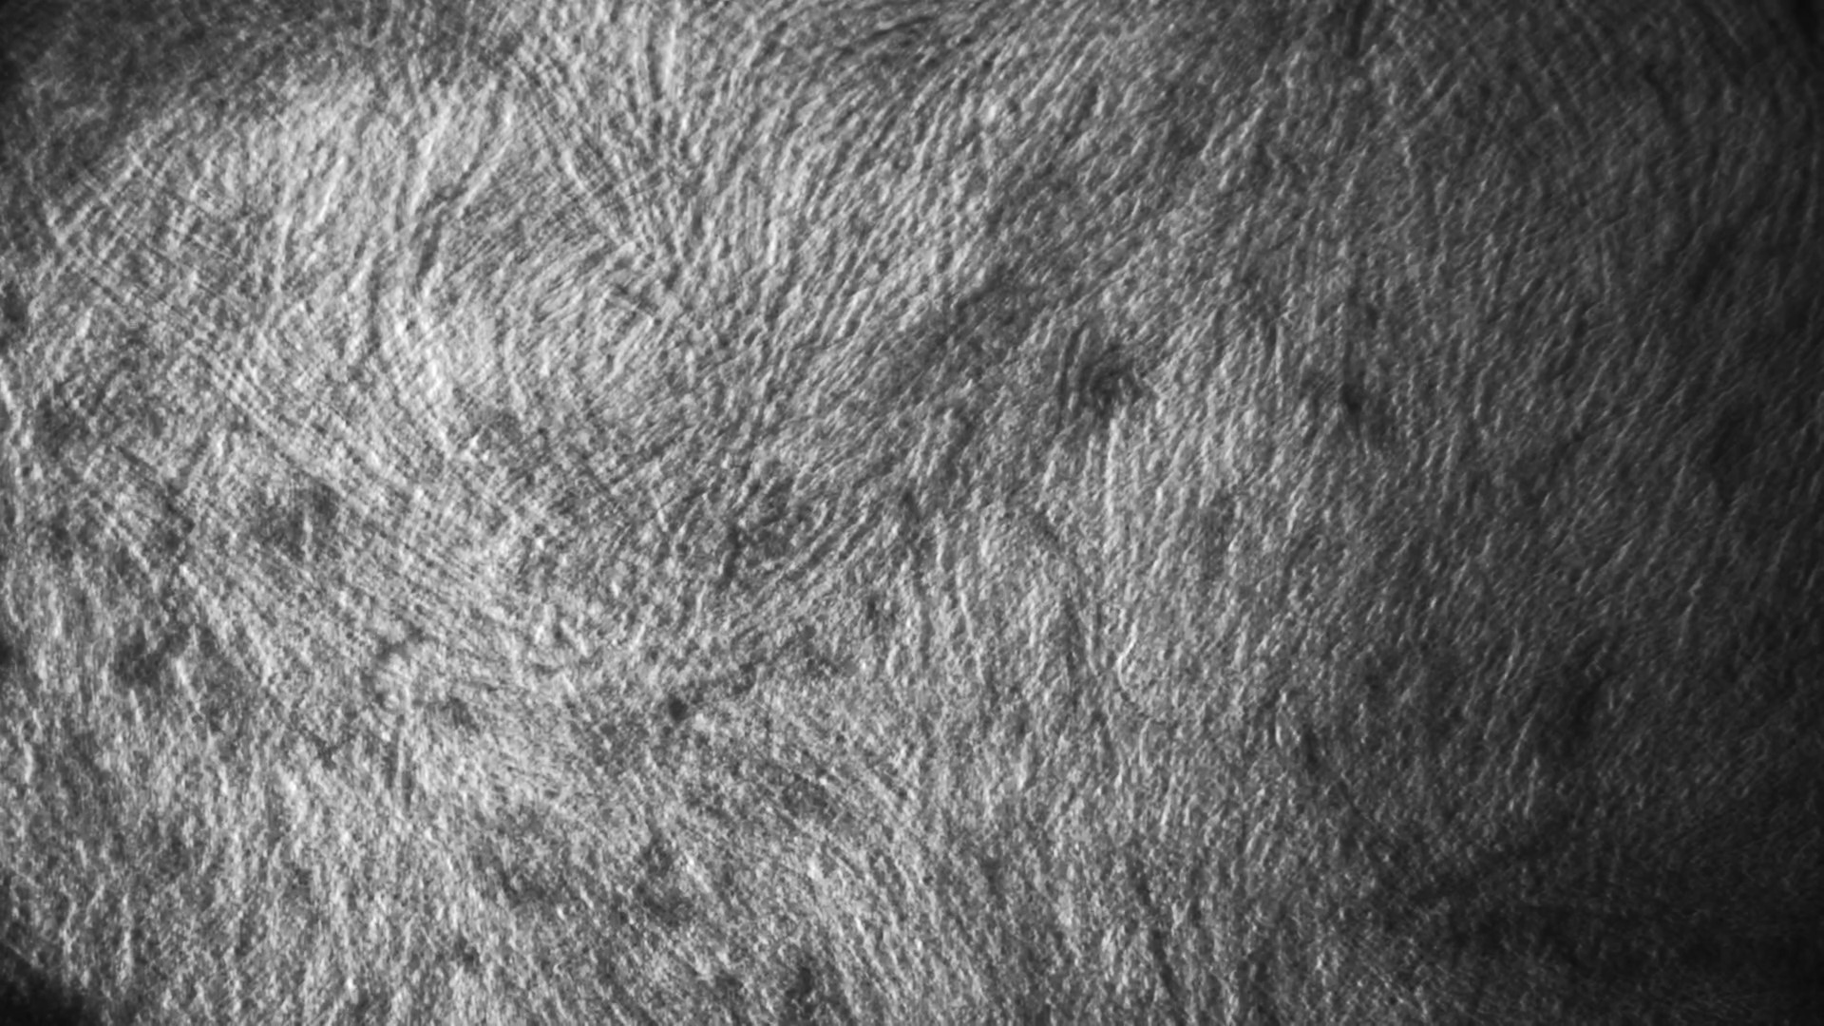

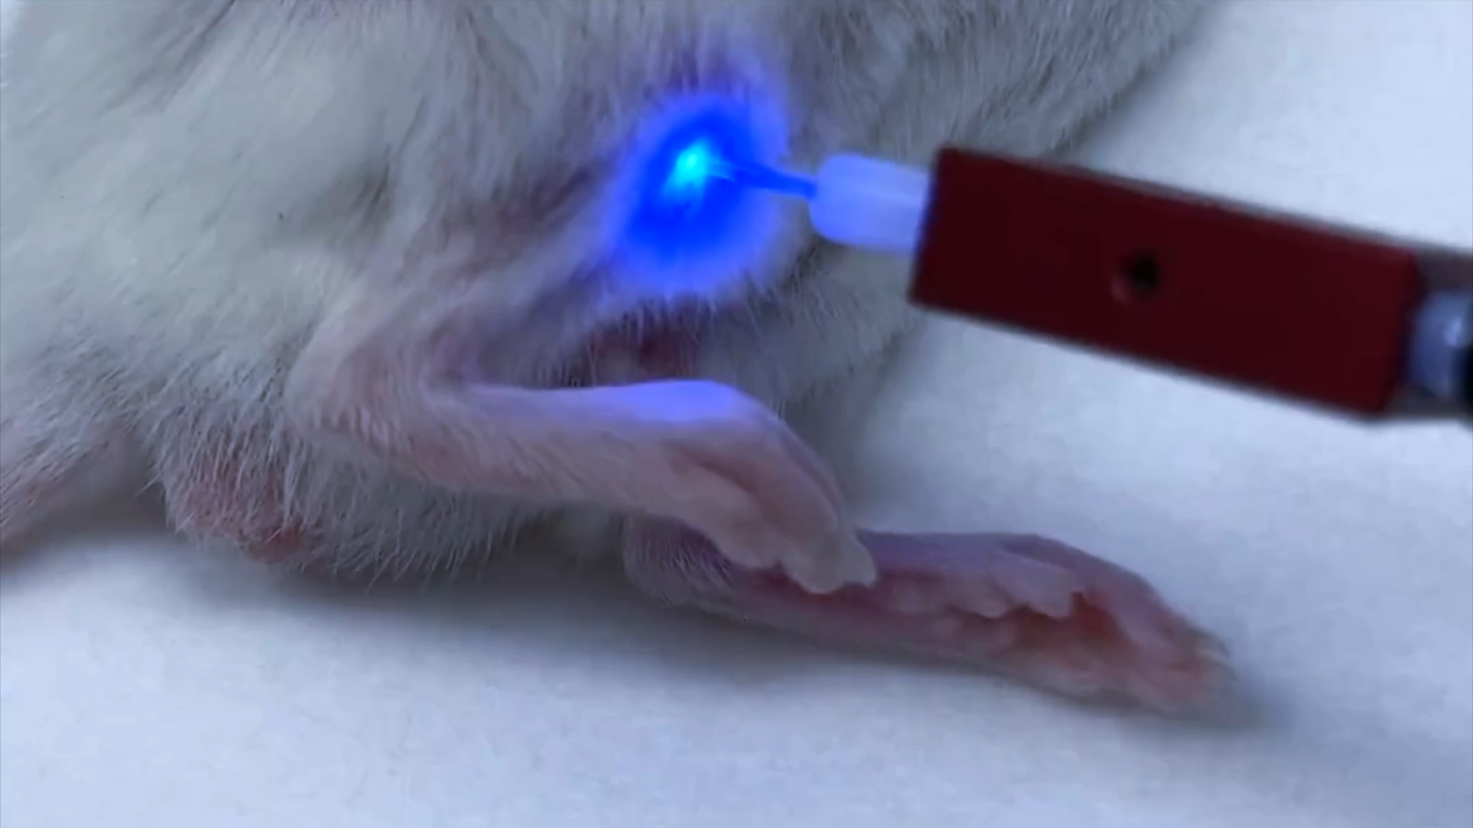
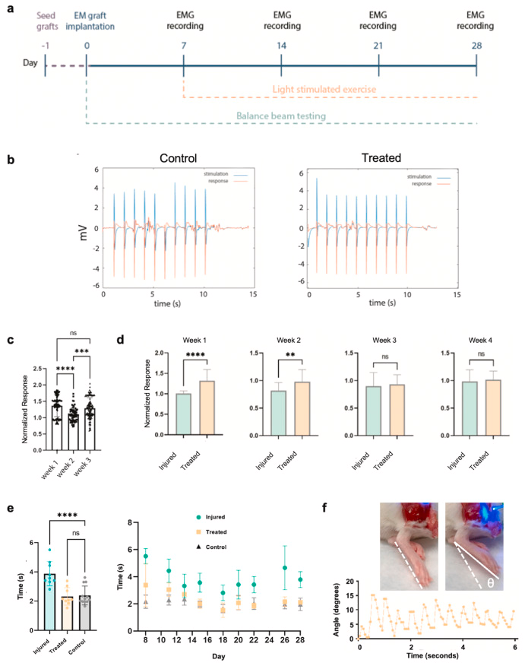
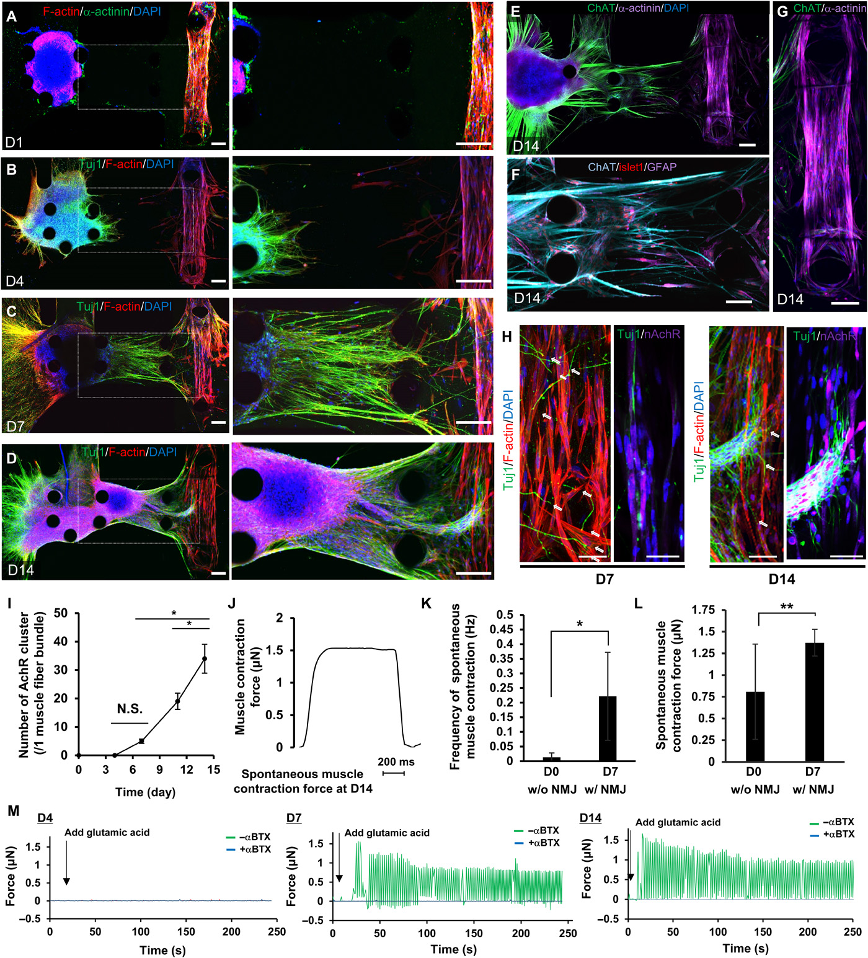
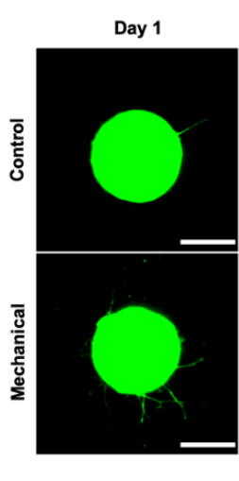
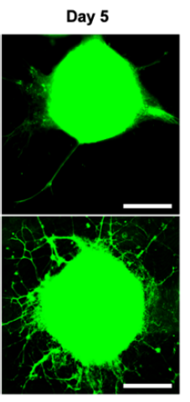
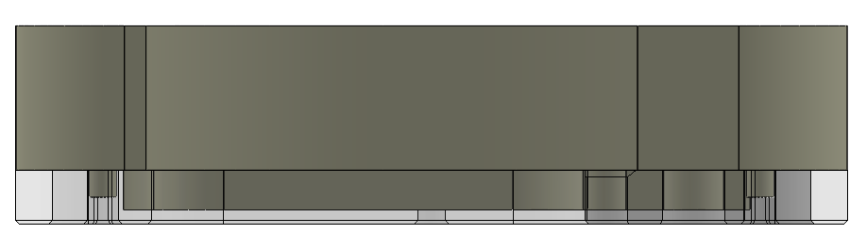
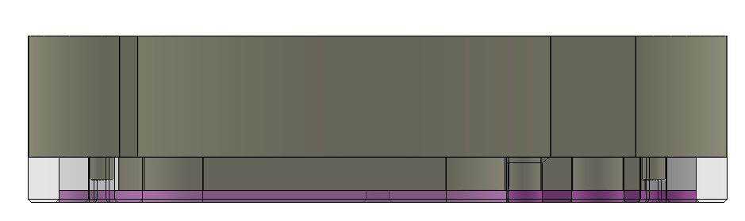
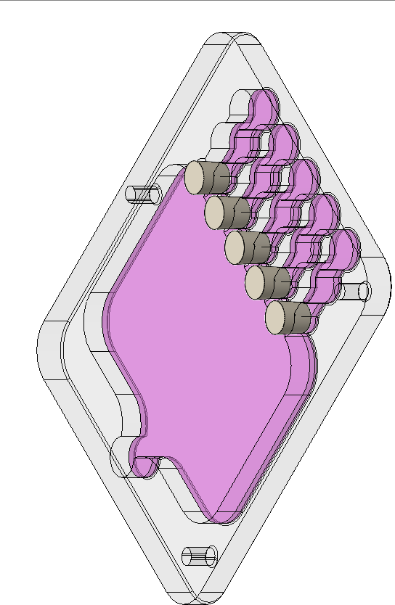
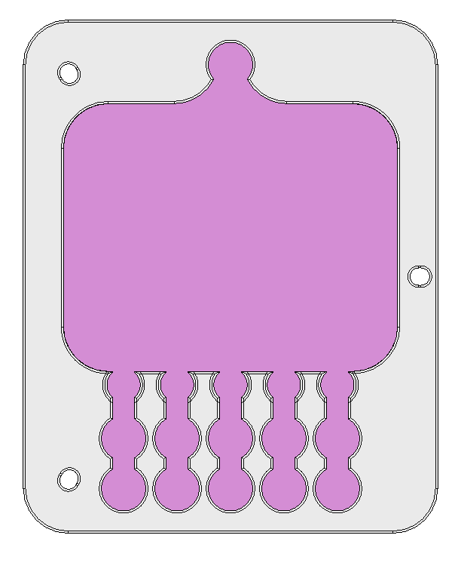
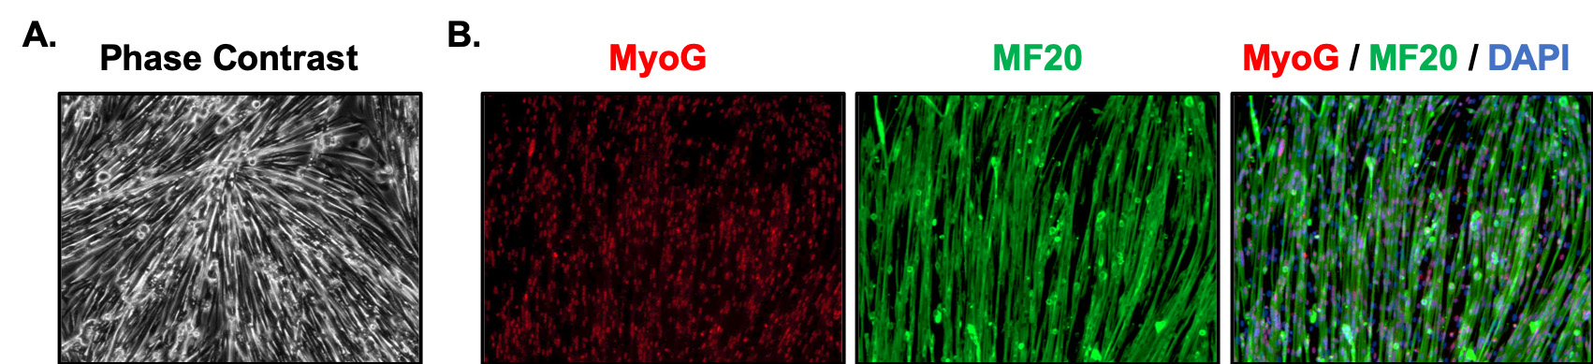

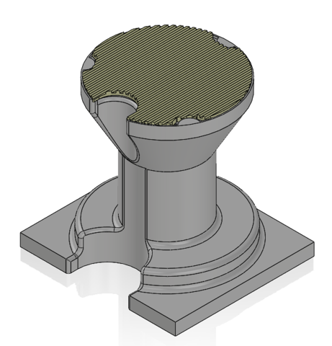
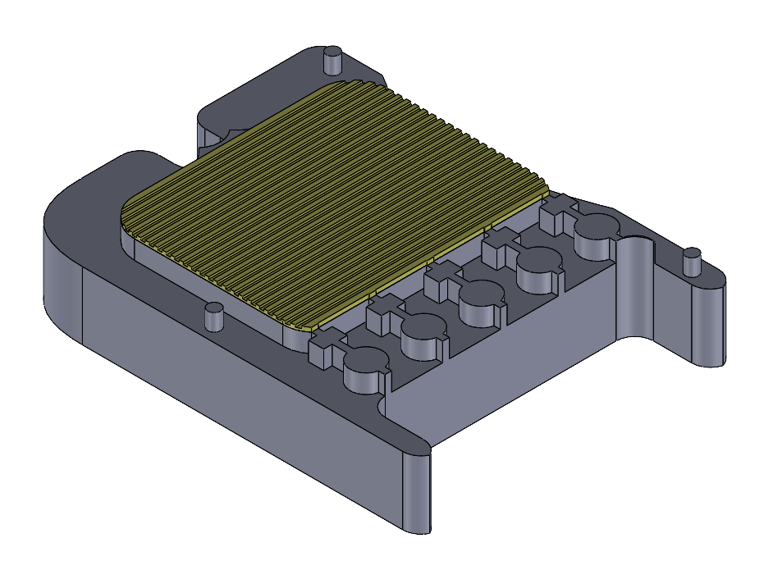
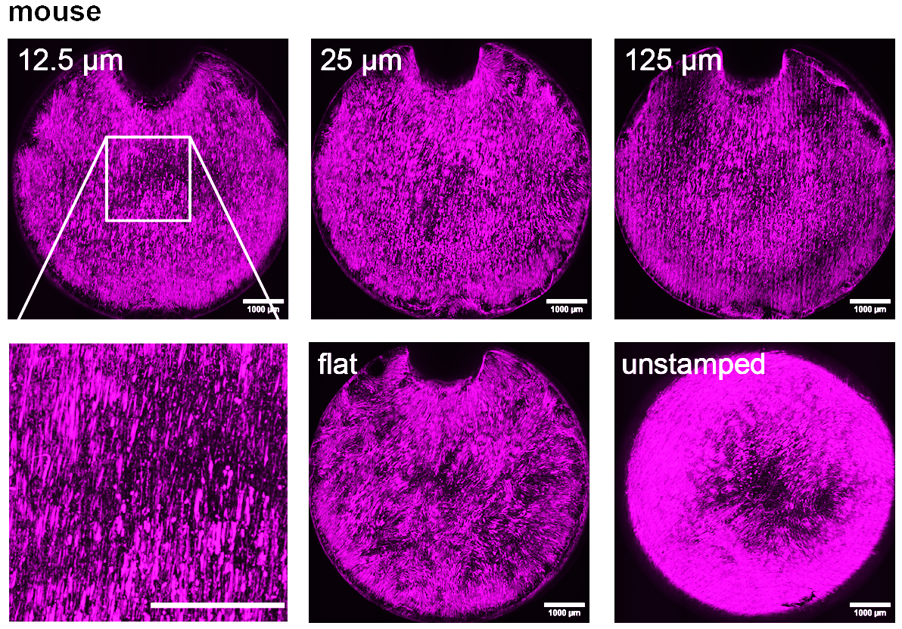
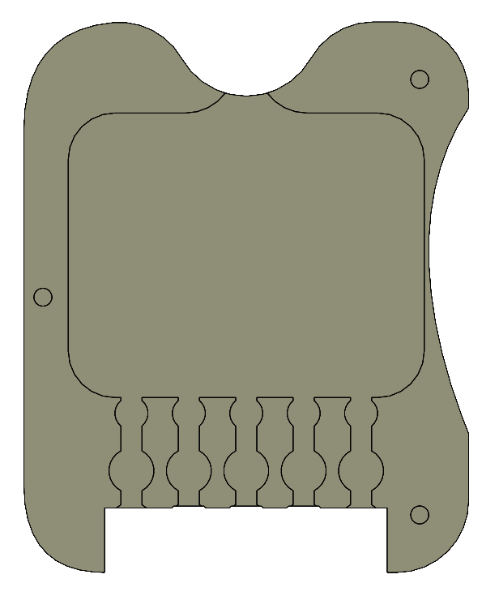
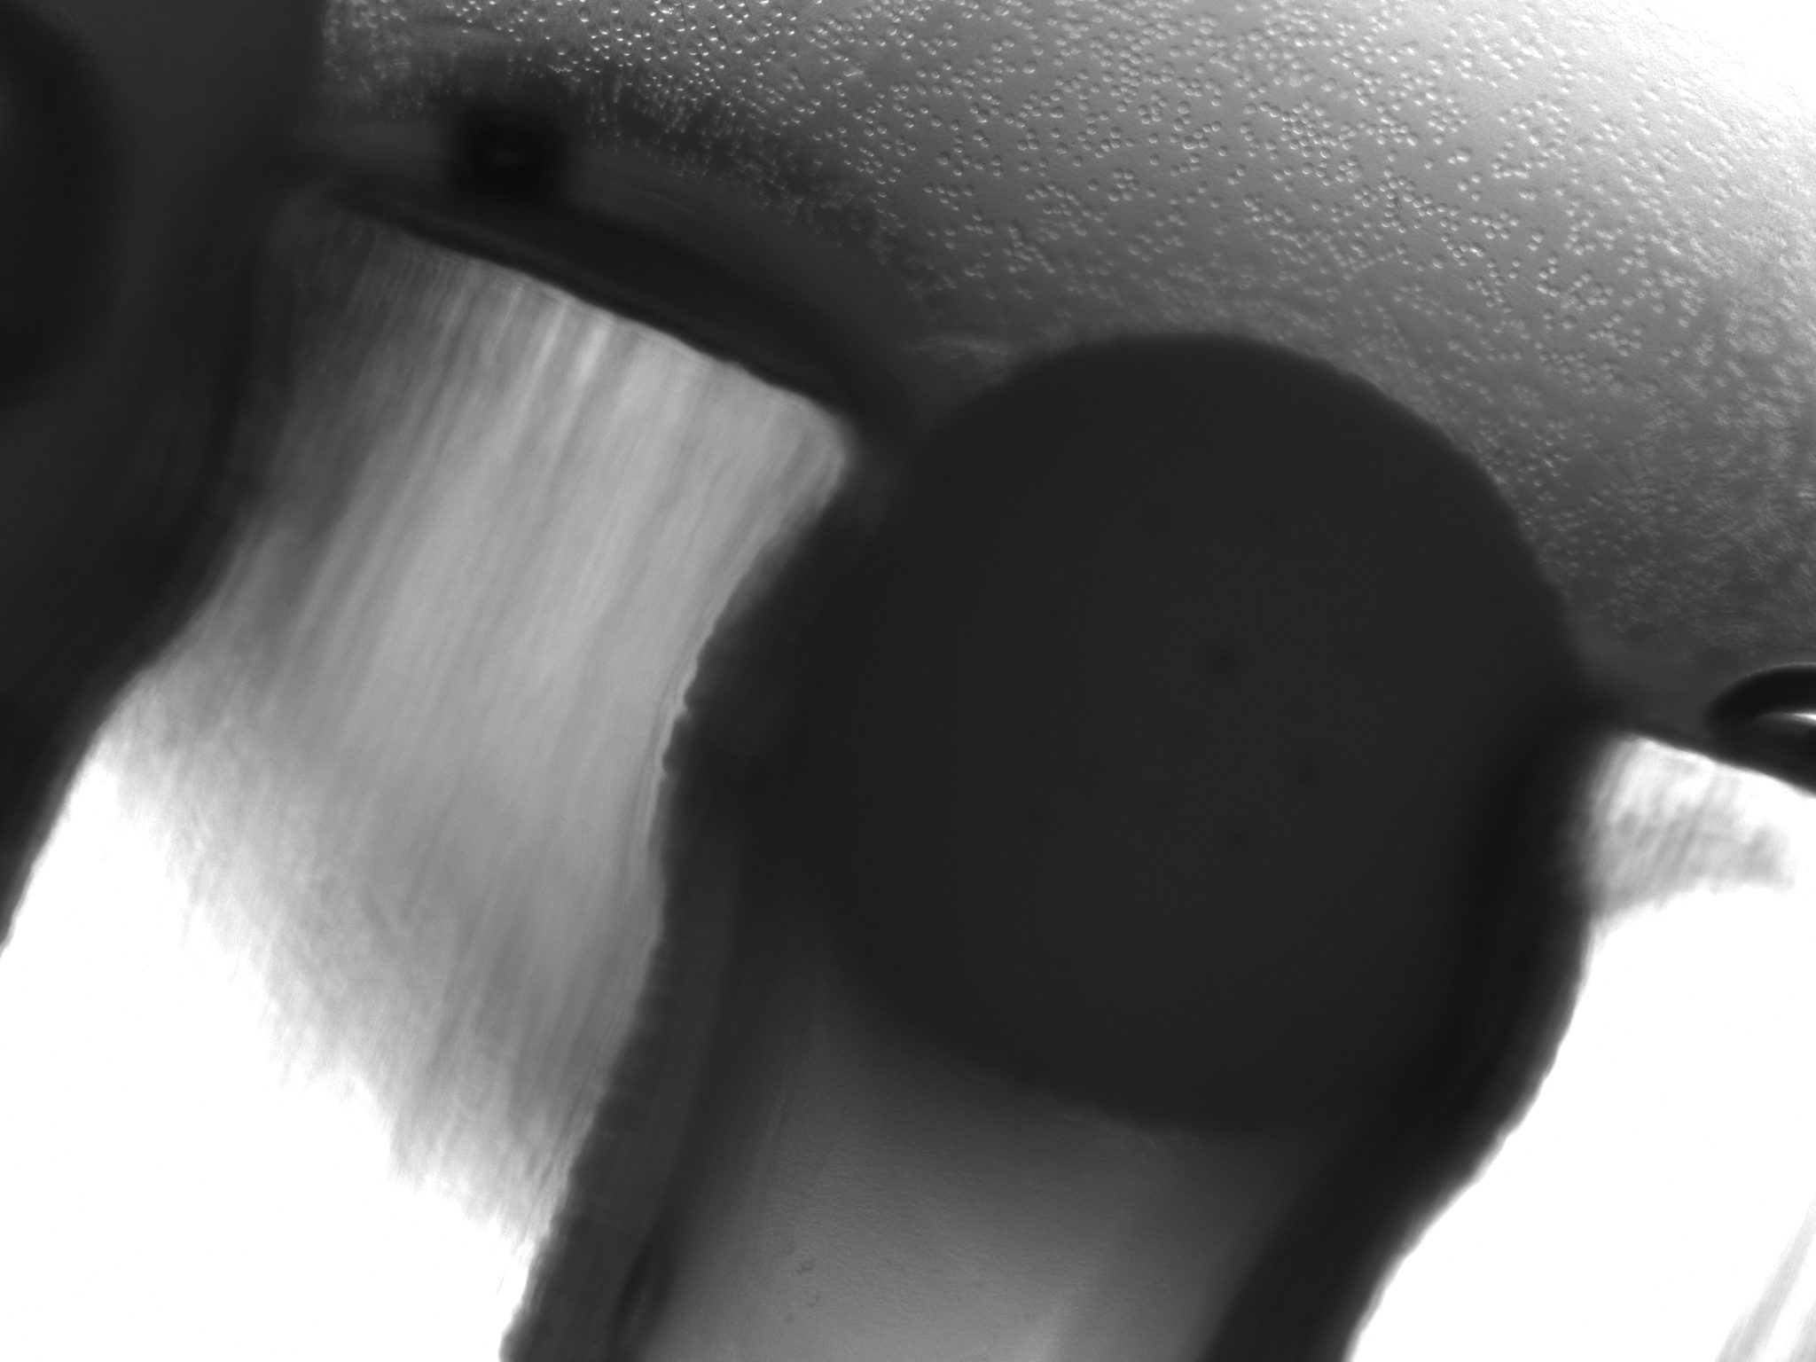
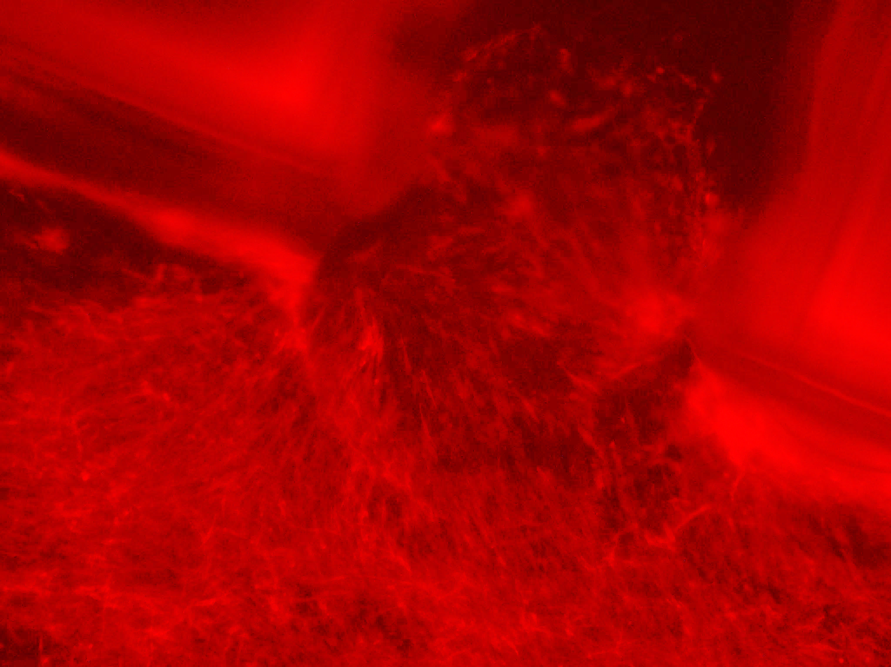
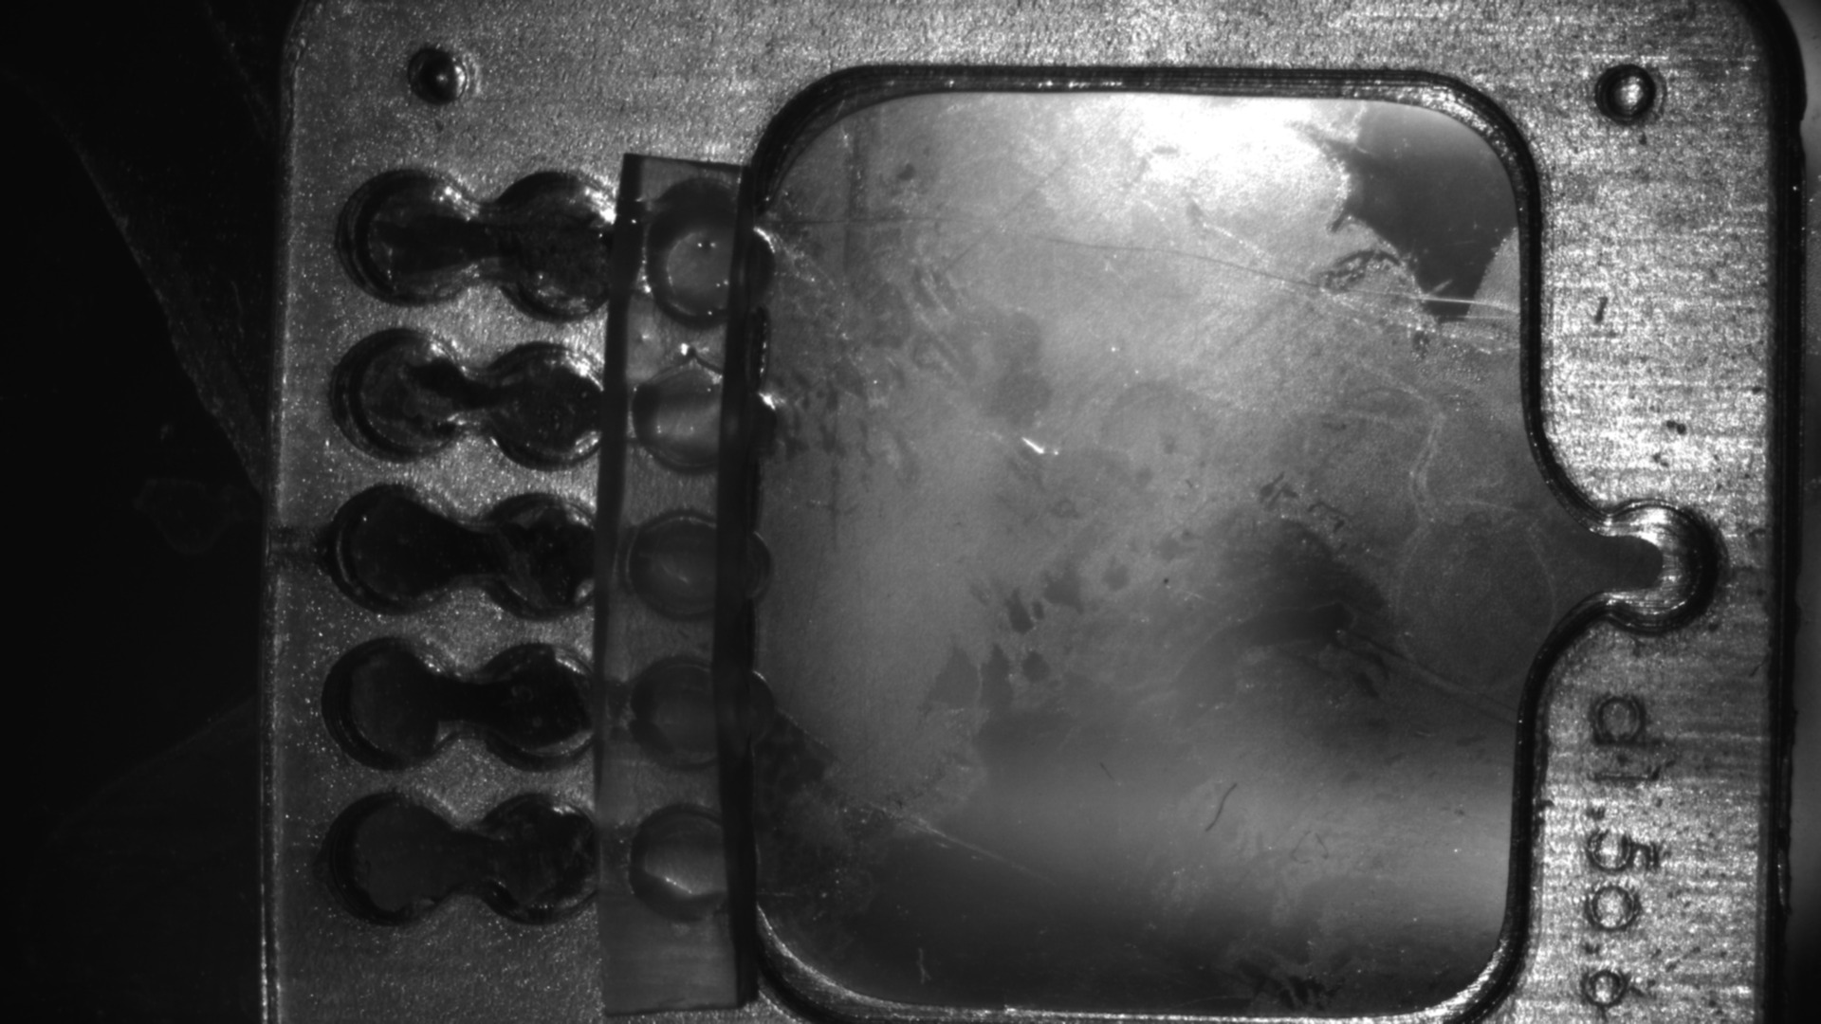
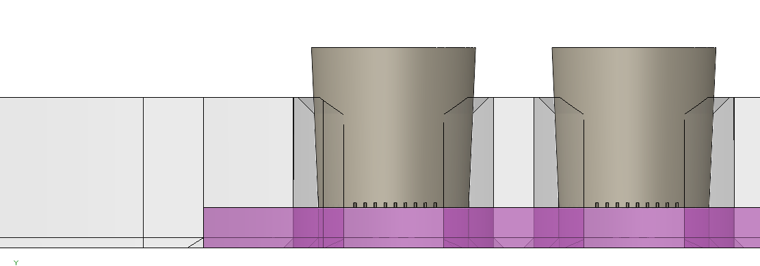
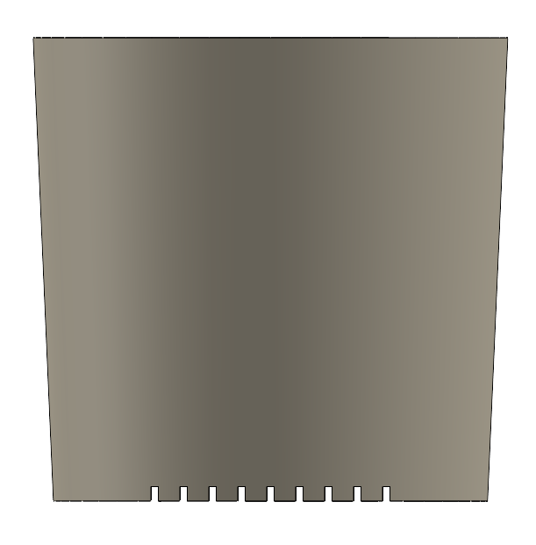
Developing Multistage Fluidic Chips for Muscle and Neuron Co-Culture
Laura Schwendeman, Tamara Rossy, Ronald Heisser, Ritu Raman
Department of Mechanical Engineering, MIT
Introduction
Methods & Assembly
Results: Cell Viability
Studies in vivo and in vitro have suggested that exercise may lead to improved motor neuron regrowth in the event of injury
Co-Culturing motor neurons and skeletal muscle in vitro in chip formats could provide insight into the effects of exercise on the formation of functional motor units at a tissue level
Goal: Develop a mesoscale fluidic chip that can easily image and quantify neurite growth in response to exercised skeletal muscle tissue
1. Adhere chip to glass
2. place stamp stage
3. Load hydrogel and polymerize
4. Remove stamp
Muscle tissue is morphologically and functionally viable long term
G1/D0
D2
D5
D13
[1]
Twitch response to blue light by day 5 after initial differentiation
Video of muscle twitch, D5
[2]
[3]
5. Seed muscle and neuron cultures
6.Grow tissue and exercise muscle
7. Measure neurite outgrowth and synaptic activity
4. Place polymer plugs
Conclusions & Future Steps
polymer plugs
Current design and materials facilitate the growth of viable 2D skeletal muscle cultures
Main barrier is muscle infiltration after removal of polymer plug barriers
Next Steps:
Add microchannels to plugs to maintain separation of cultures while allowing neurites through
Add microgrooves to stamp for muscle fiber alignment, as done in [4]
Add neuron spheroids to wells
Design
Optogenetically Engineered Skeletal Muscle
Neuron Spheroids
We designed a 2D “spinal-cord” like chip that houses uniquely addressable motor neuron regions that grow towards a distal skeletal muscle culture
Features:
Uniform hydrogel substrate to support skeletal muscle twitch
Monolayer cultures for clear, live imaging
Open well for chemical crosstalk
Results: Initial Culture Separation
[4]
[4]
Polymer plugs contain muscle tissue culture in muscle well. Upon removal, muscle fibers begin to invade neuron channels
Stamp Overmold
Rigid Chip
Gel Inlet Port
Gel
Muscle Well – “limb”
Kinematic Pin Slot
Plug Wells
Neuron Wells – “Spinal Cord”
4 mm
Microchannels
0.5 mm
1 mm
Citations:
Gel Outlet Ports
Upon seeding myoblasts remain outside neuron channels
1 day after removing plugs, 5 days after culture on differentiation media
1. Rousseau E, Raman R, Tamir T, et al. Actuated tissue engineered muscle grafts restore functional mobility after volumetric muscle loss. Biomaterials. Published online September 8, 2023:122317. doi:10.1016/j.biomaterials.2023.122317
2. Bu A, Afghah F, Castro N, et al. 2.5D Actuating Substrates Enable Decoupling the Mechanical and Biochemical Effects of Muscle Exercise on Motor Neurons. Published online March 6, 2024:2024.03.02.583091. doi:10.1101/2024.03.02.583091
3. Osaki T, Uzel SGM, Kamm RD. On-chip 3D neuromuscular model for drug screening and precision medicine in neuromuscular disease. Nature Protocols. Published online 2020. doi:10.1038/s41596-019-0248-1
4. Rossy T, Schwendeman L, Bawa M, Umashankar P, Raman R. Leveraging microtopography to pattern multi-oriented muscle actuators. Published online August 1, 2024:2024.07.31.606059. doi:10.1101/2024.07.31.606059

